Slide 1
DBMS
Cse-307

Slide 2
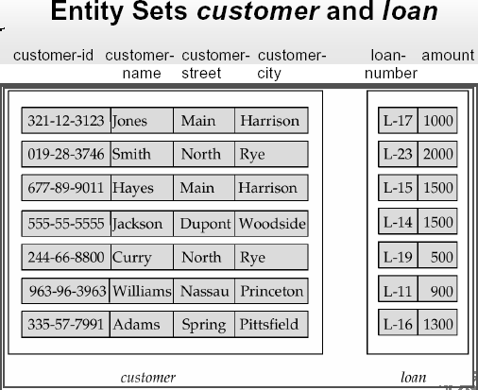
Entity relationship model
Entity: An entity is a “thing” or “object” in the real world that is distinguishable from all other objects.
Example: specific person, company, event, plant
Entity Set: An entity set is a set of entities of the same type.
Example: set of all persons, companies, trees, holidays

Slide 3
Entity relationship model basic
Column- Attribute
Row- Tuple
Table- Relation
Attributes: six (6) types
- Simple Attribute - Composite Attribute - Single Valued Attribute - Multi-valued - Derived Attribute - Descriptive Attribute

Slide 4
Attributes
Simple Attribute:
Can’t be divided into subparts. Example: Roll, Customer_id, Reg_no etc
Composite Attribute:
Can be divided into subparts. Example: Name (first_name, middle_name,last_name),
address etc.
Single Valued Attribute: Which column has unique value. Example: Roll, Reg_No, Cus_id
Multi-valued Attribute: May contains duplicate value. Example: Name, Phn_No etc.

Slide 5
Attributes(cont.)
Derived Attribute: Which value depends on another attribute. Example: Age (depends on Birth_date )
Descriptive Attribute: The table which make a relation between another two tables (by taking the primary key as foreign key), have any own attributes, called Descriptive.
Example: ……[This Attributes describe later at the E-R diagram topic]

Slide 6
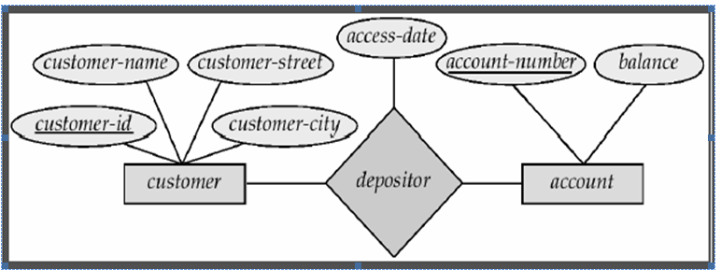
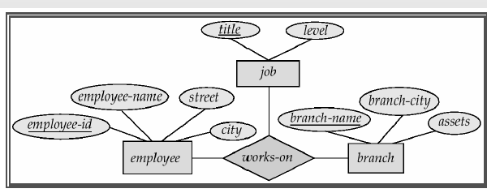
Degree of relationship(binary & ternary)

Slide 7
Mapping cardinality
One to One
One to Many
Many to One
Many to Many

Slide 8
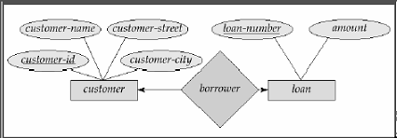
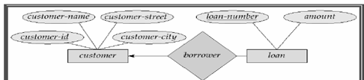
Mapping cardinality(cont.)
One to One & One to Many:

Slide 9
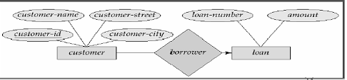
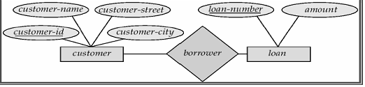
Mapping cardinality(cont.)
Many to One & Many to Many:

Slide 10
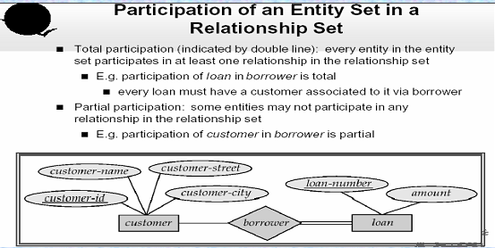
Participation constraints

